Slide 1
Speed, Wavelength, Frequency
Light speed = 3 x 10⁸ m/s = 300,000 km/s
Velocity of light = Frequency x Wavelength (C=λν)
System | Frequency | Wavelength
AC current | 60 Hz | 5,000 km
FM radio | 100 MHz | 3 m
Cellular | 800 MHz | 37.5 cm
Ka band satellite | 20 GHz | 15 mm
Ultraviolet light | 10¹⁵ Hz | 10⁻⁷ m

Slide 2
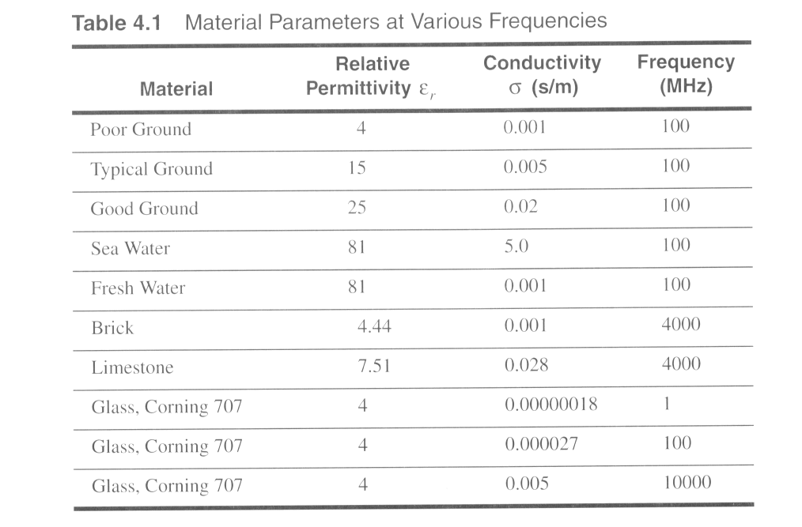
Typical electromagnetic properties

Slide 3
Propagation Mechanisms
Reflection
Propagation wave impinges on an object which is large as compared to wavelength – (Cellular - 900MHz –wavelength- 37.5 cms)
- e.g., the surface of the Earth, buildings, walls, etc.
Diffraction
Radio path between transmitter and receiver obstructed by surface with sharp irregular edges
Waves beyond around the obstacle, even when LOS (line of sight) does not exist
Scattering
Objects smaller than the wavelength of the propagation wave
- e.g. foliage, street signs, lamp posts

Slide 4
Radio Propagation Effects
Building
Direct Signal
h_{b}
Reflected Signal
Diffracted Signal
h_{m}
d
Transmitter
Receiver

Slide 5
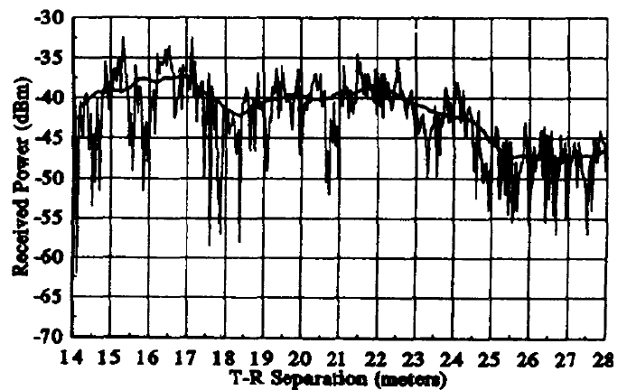
Fading
Small Scale fading
Instantaneous received power variation
Delay spread
Doppler spread
Large scale fading
Path loss
Shadowing
Obstacles

Slide 6
Free-space Propagation Model
h_{b}
h_{m}
Transmitter
Distance d
Receiver
The received signal power at distance d:
where P_{t} is transmitting power, A_{e} is effective area, and G_{t} is the transmitting antenna gain. Assuming that the radiated power is uniformly distributed over the surface of the sphere.

Slide 7
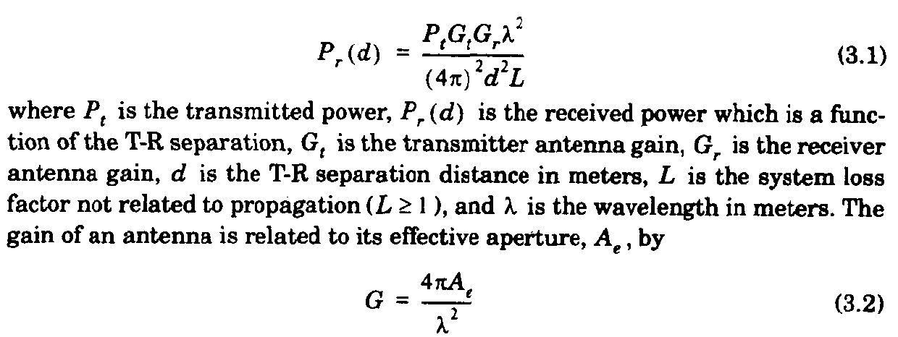
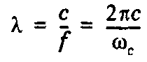
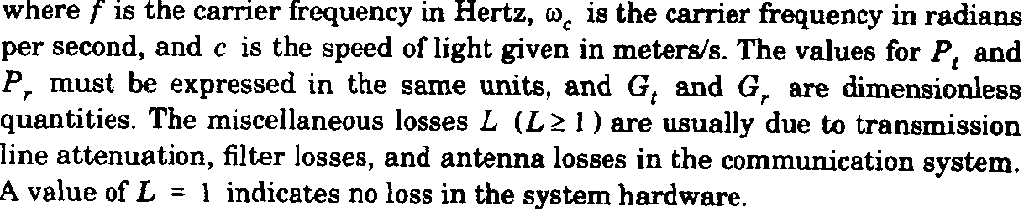
Free-space Propagation Model (contd.)

Slide 8
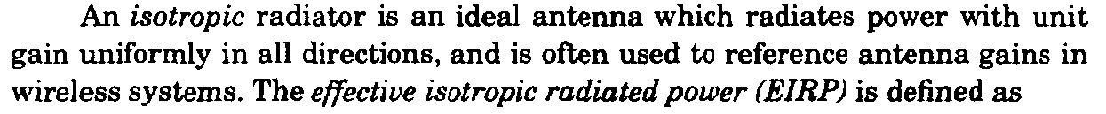
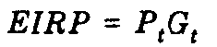

Slide 9
Antenna Gain
For a circular reflector antenna
Gain G = η ( π D / λ )²
η = net efficiency (depends on the electric field distribution over the antenna aperture, losses, ohmic heating , typically 0.55)
D = diameter
thus, G = η (π D f /c )², c = λ f (c is speed of light)
Example:
Antenna with diameter = 2 m, frequency = 6 GHz, wavelength = 0.05 m
G = 39.4 dB
Frequency = 14 GHz, same diameter, wavelength = 0.021 m
G = 46.9 dB
* Higher the frequency, higher the gain for the same size antenna

Slide 10
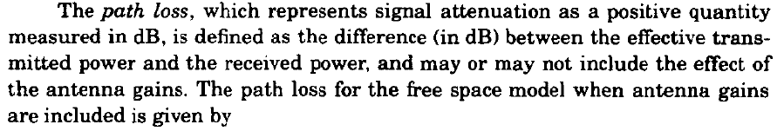
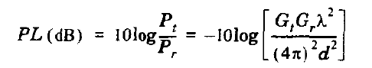
Path loss

Slide 11
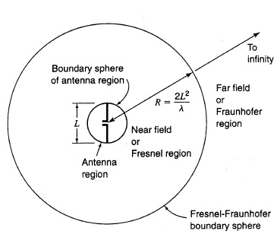
Antenna Field Zones
The dividing line “Rule of Thumb” is
R = 2L²/λ
The near field or Fresnel zone is r < R
The far field or Fraunhofer zone is r > R
L= Largest linear physical dimension

Slide 12
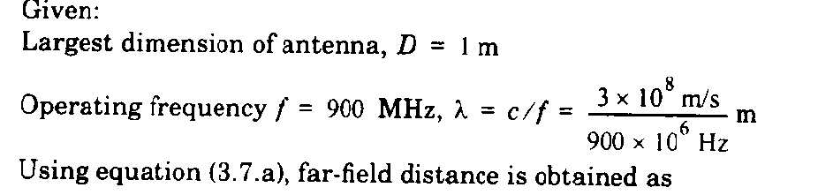
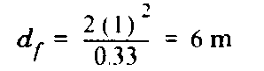

Slide 13
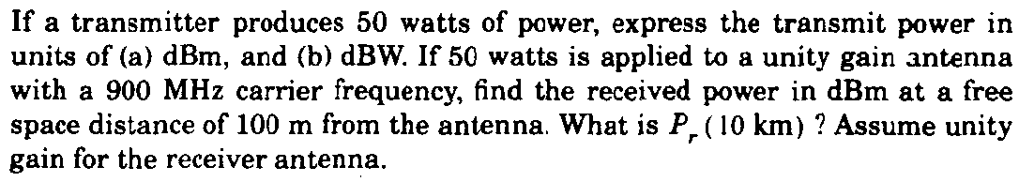
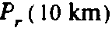
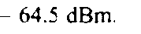

Slide 14
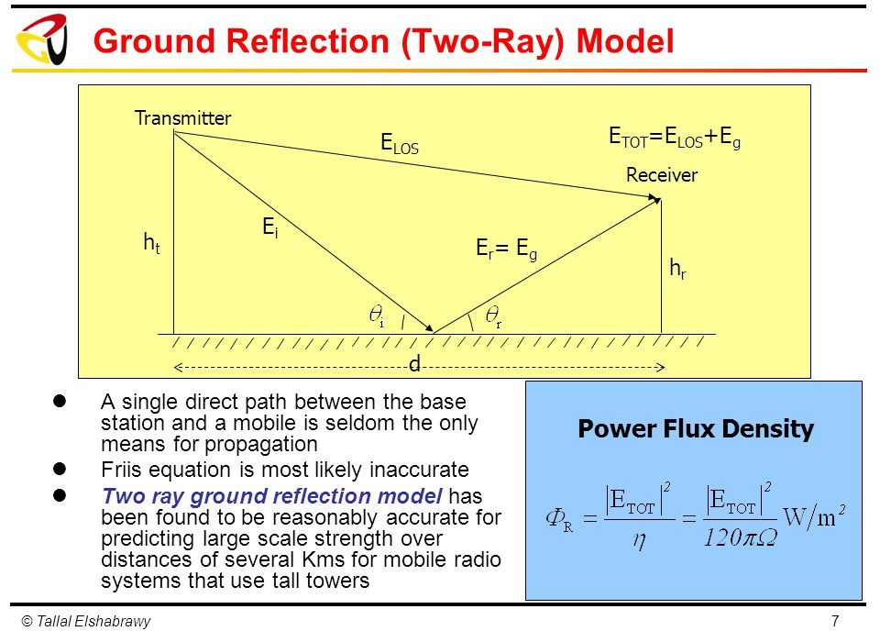
Ground reflection (Two-Ray) Model

Slide 15
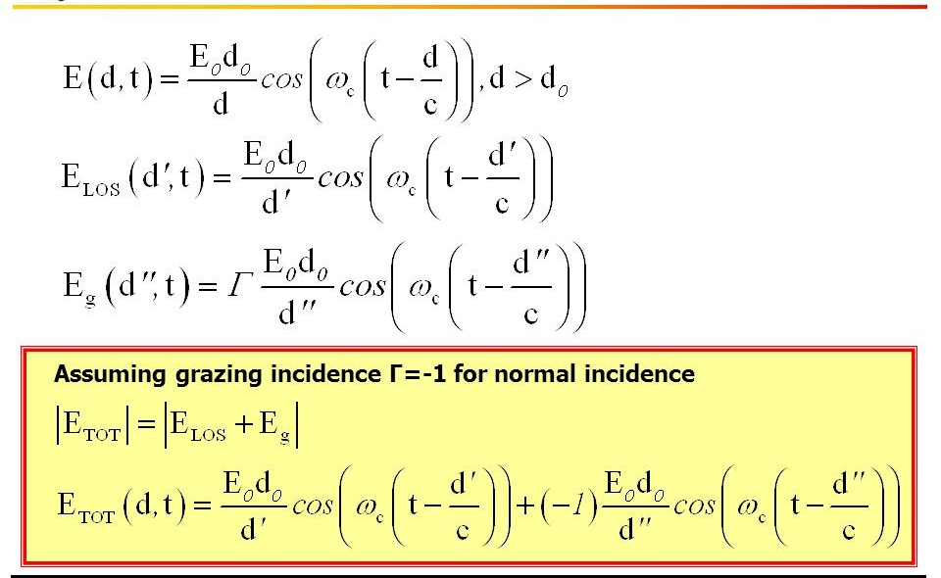

Slide 16
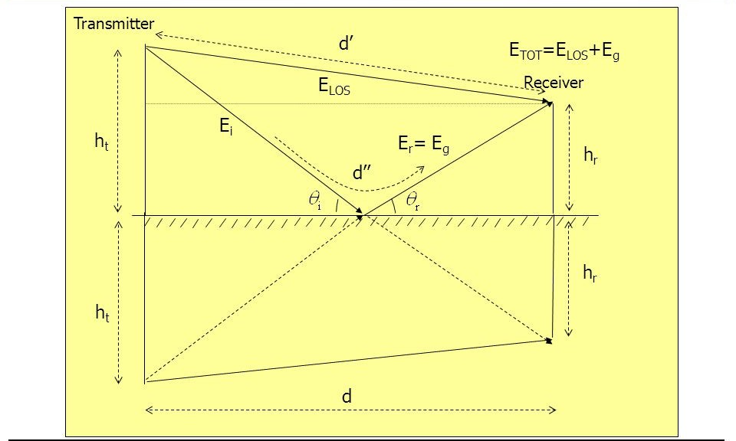
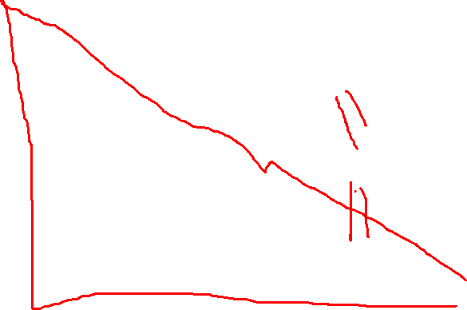

Slide 17
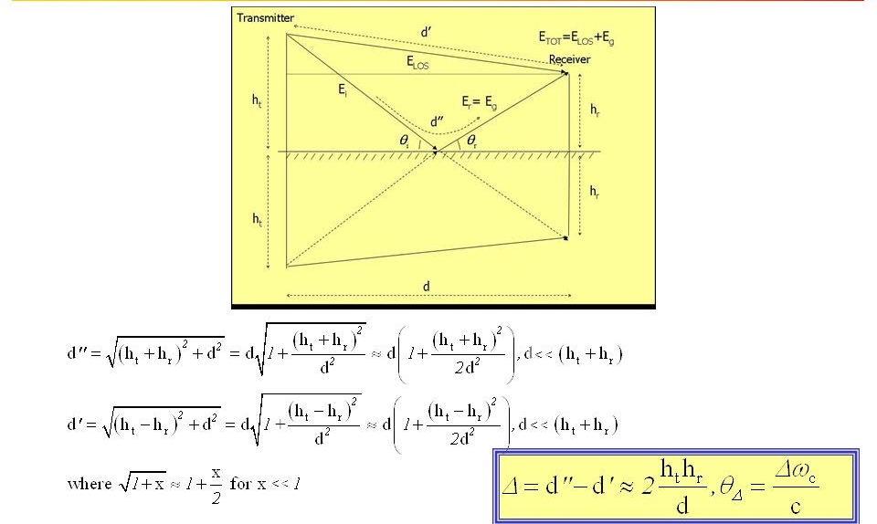

Slide 18
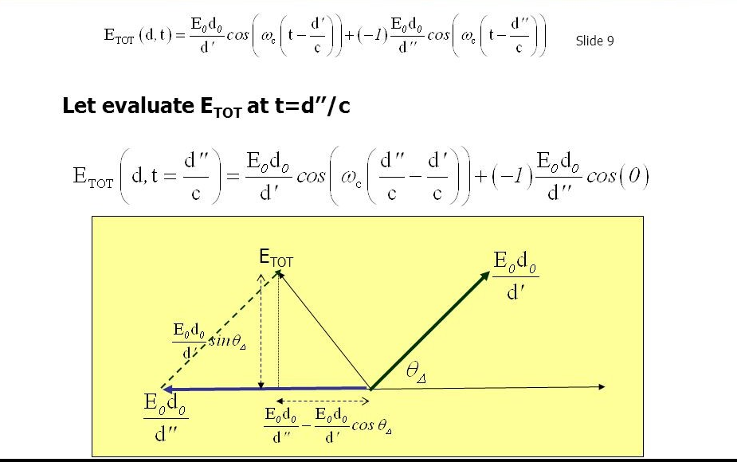

Slide 19
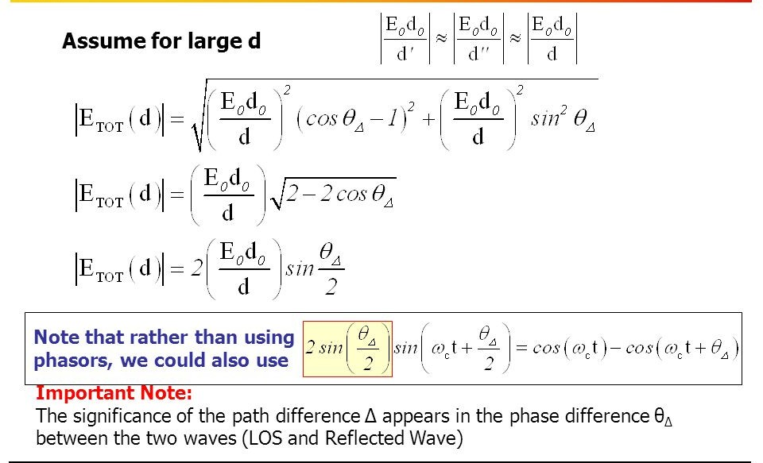

Slide 20
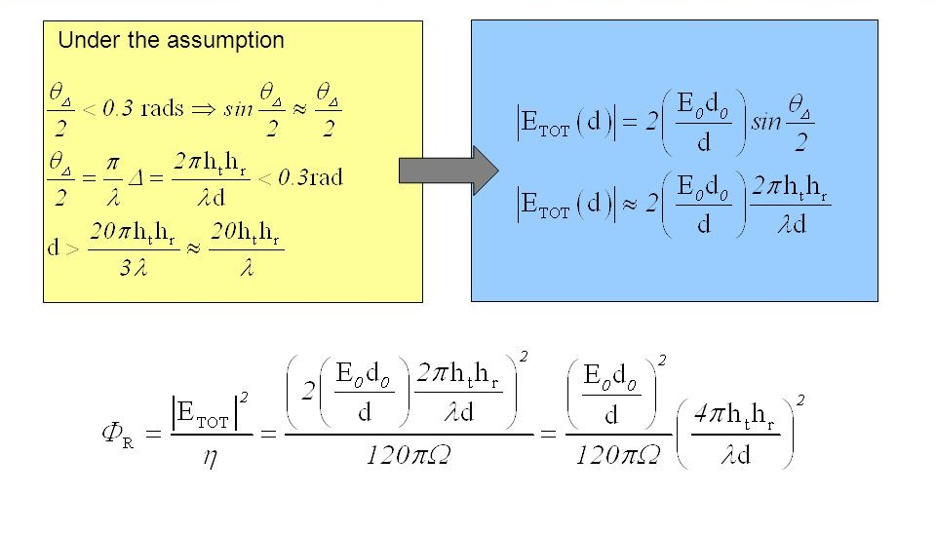

Slide 21
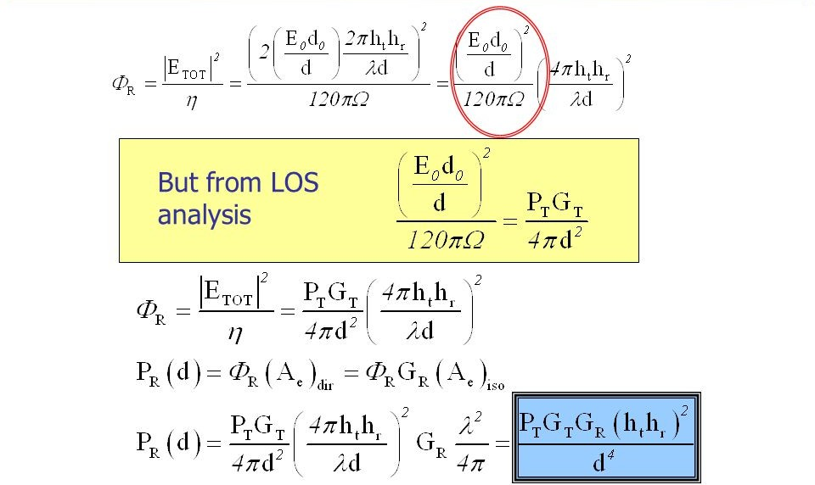

Slide 22
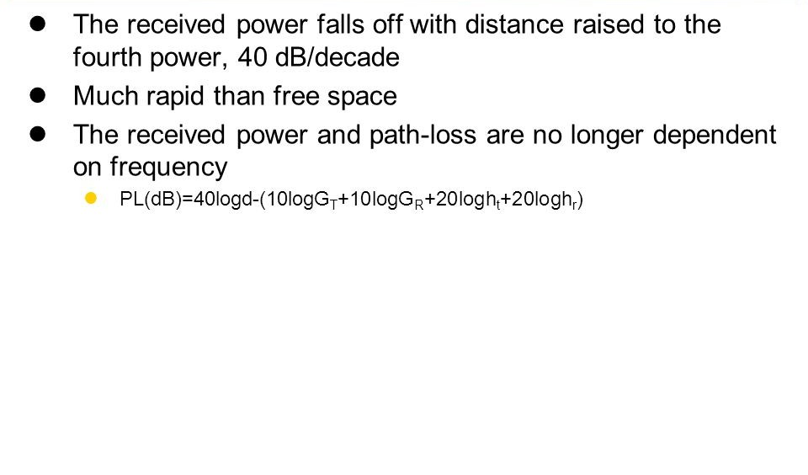

Slide 23
Outdoor and indoor propagation models,
Link budget design

Slide 24
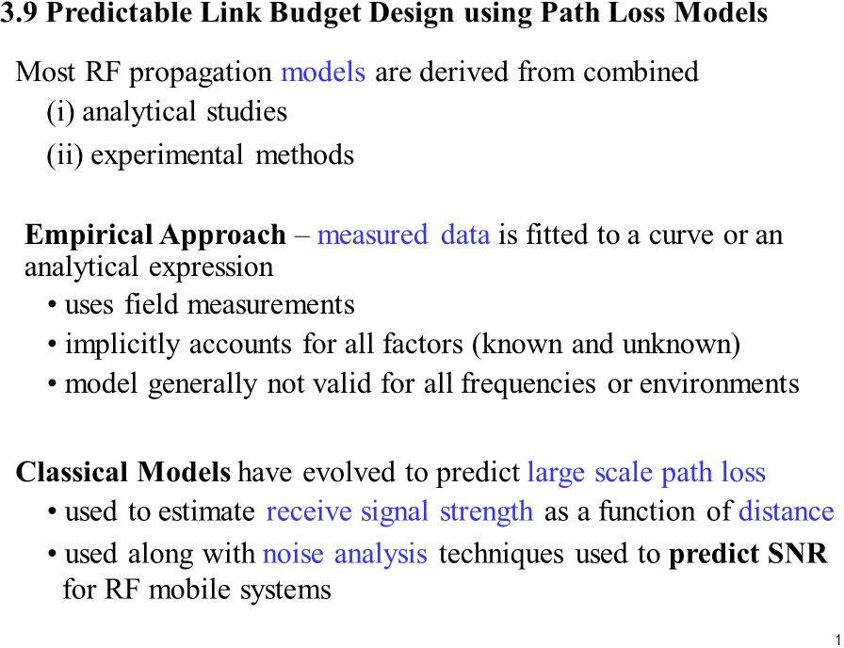

Slide 25
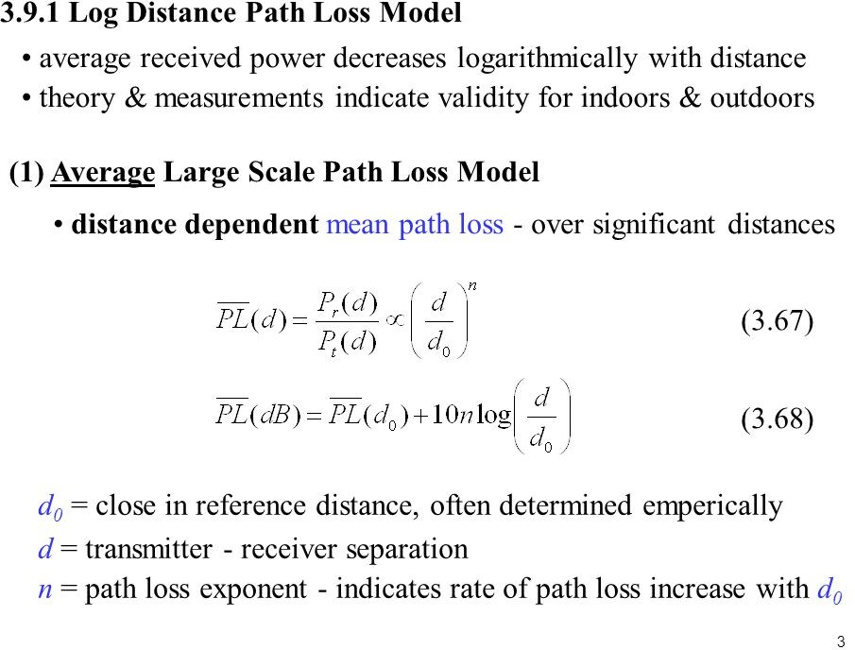
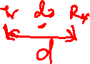

Slide 26
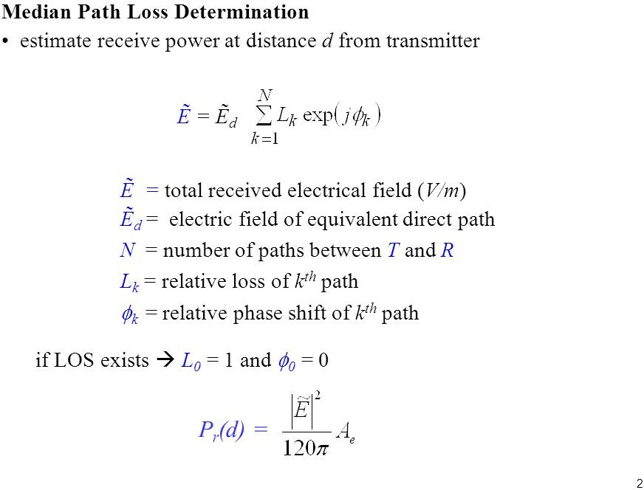
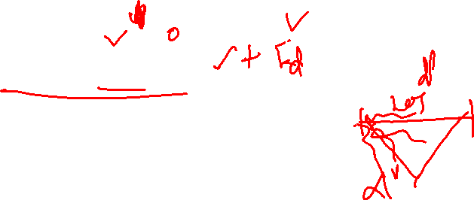

Slide 27
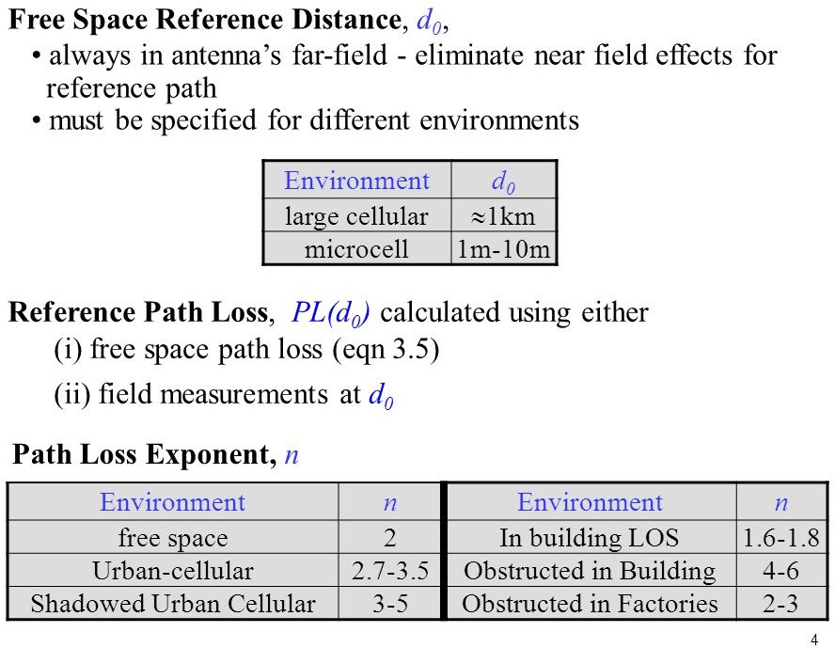

Slide 28
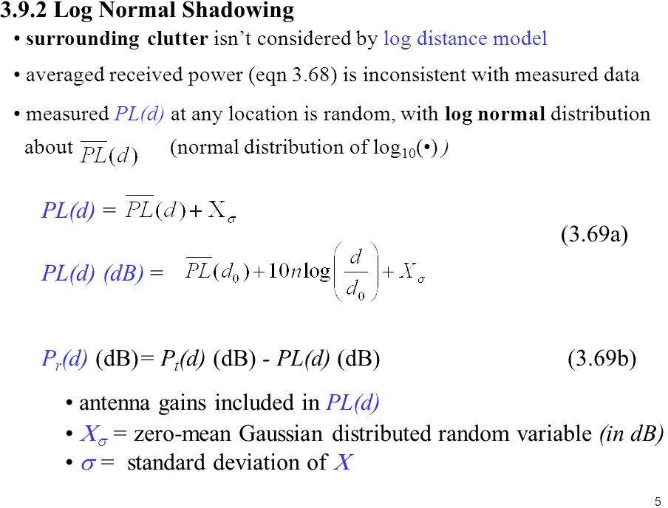
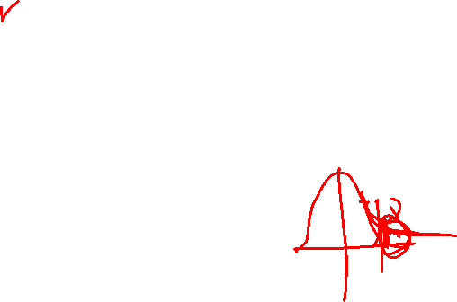

Slide 29
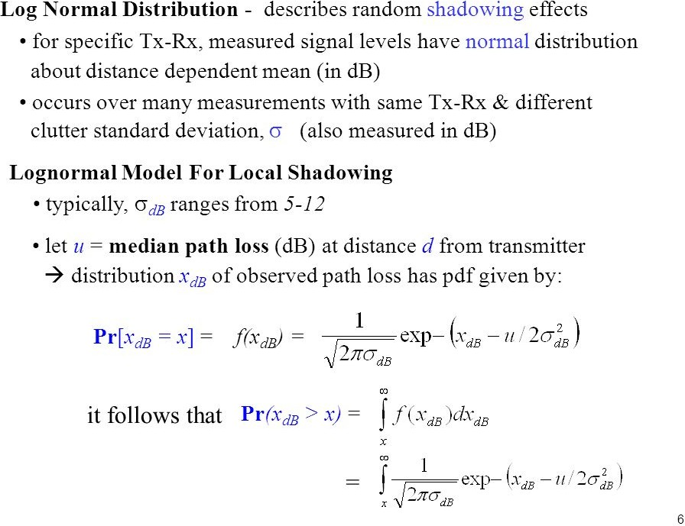
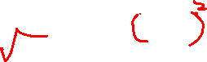

Slide 30
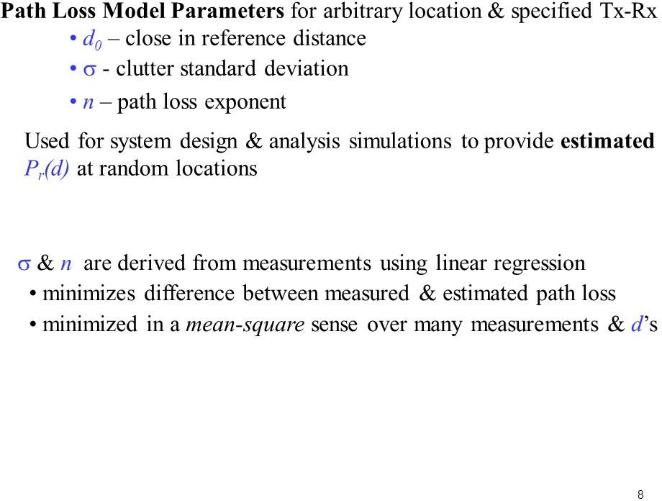

Slide 31
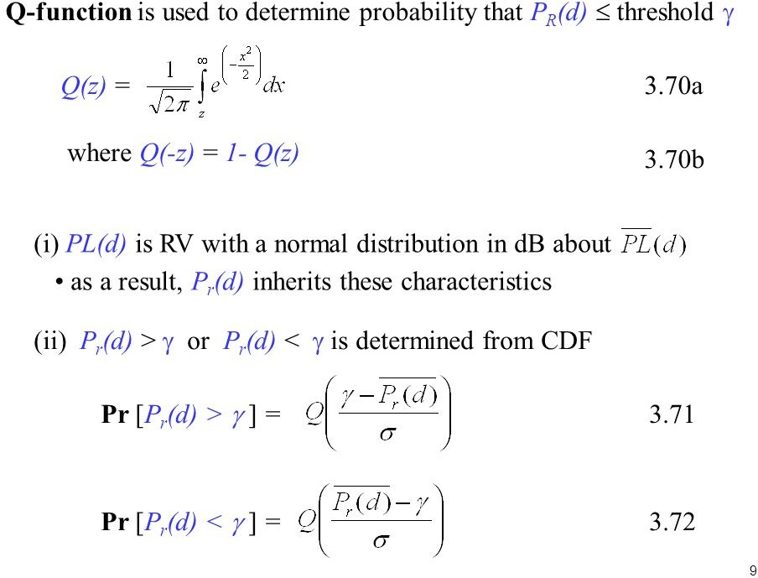


Slide 32
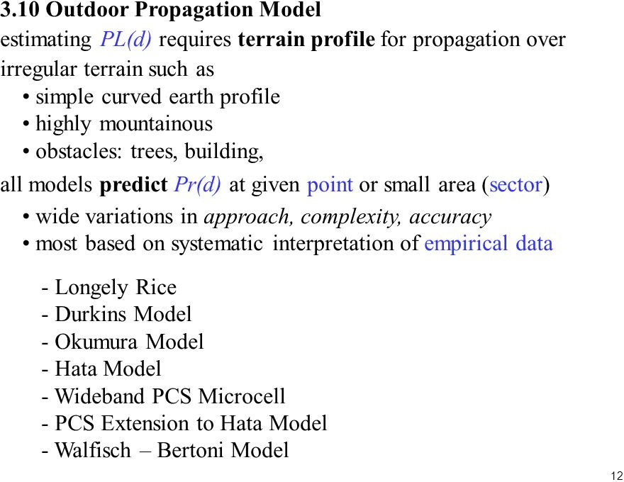

Slide 33
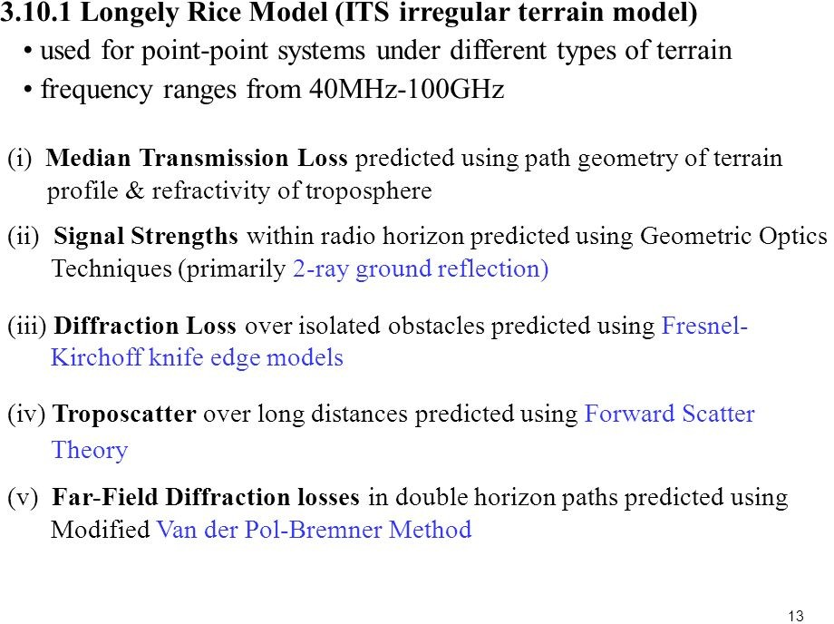

Slide 34
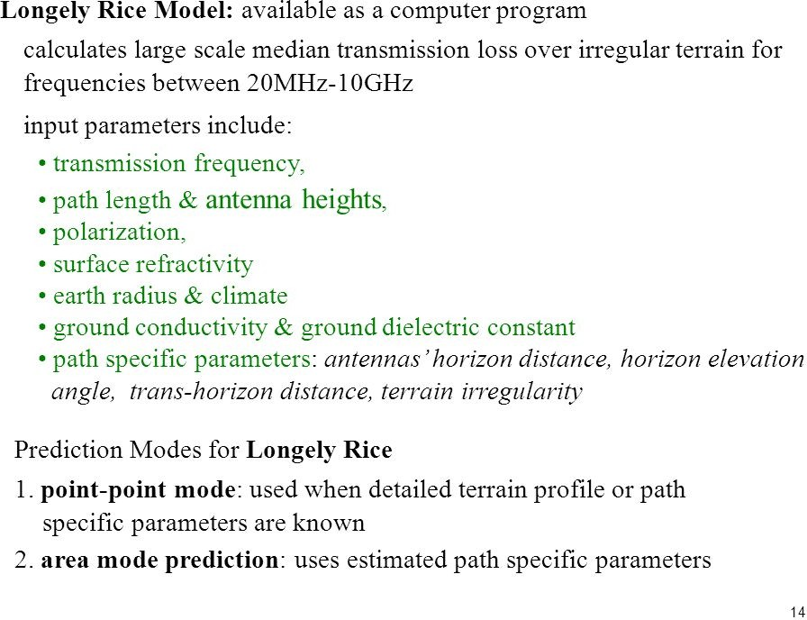

Slide 35
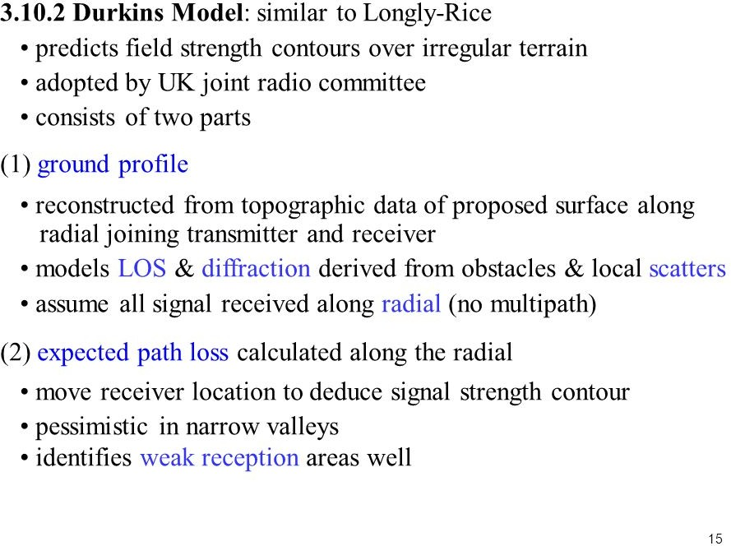

Slide 36
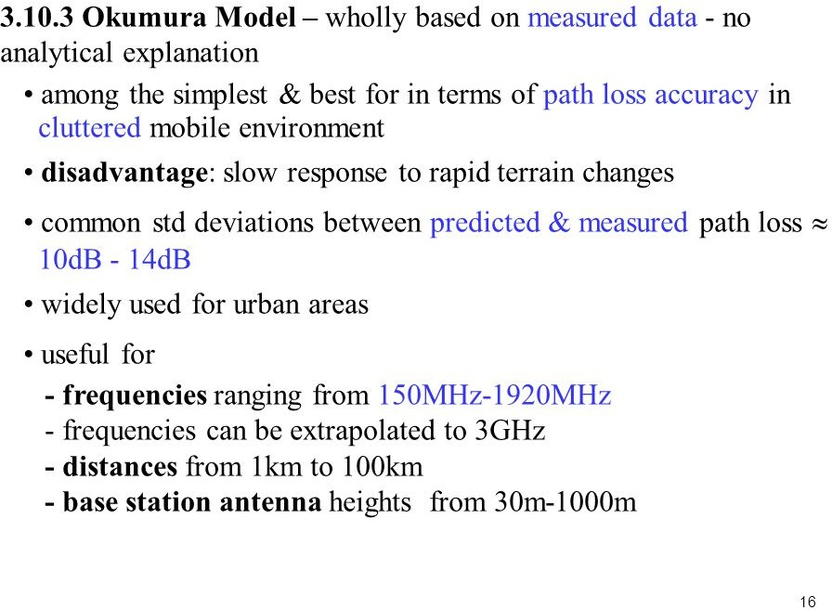

Slide 37
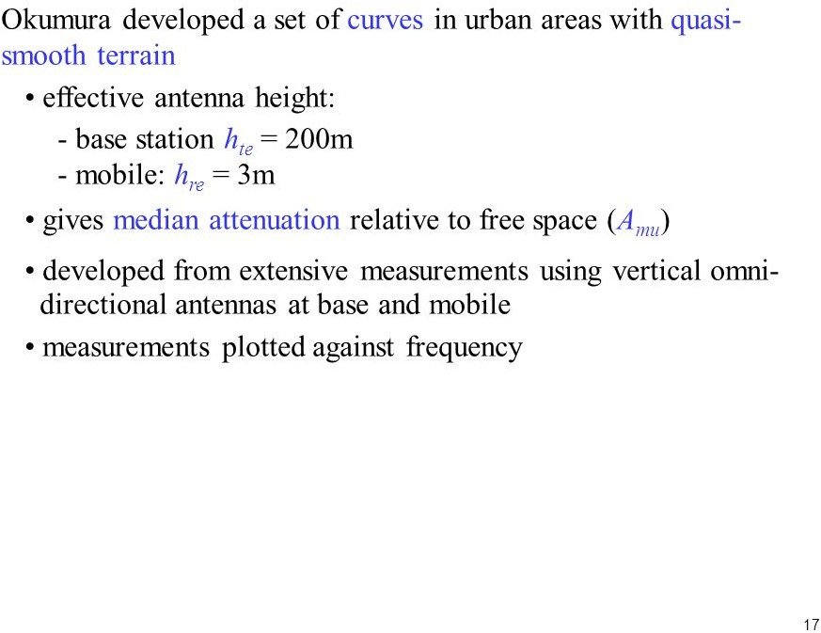

Slide 38
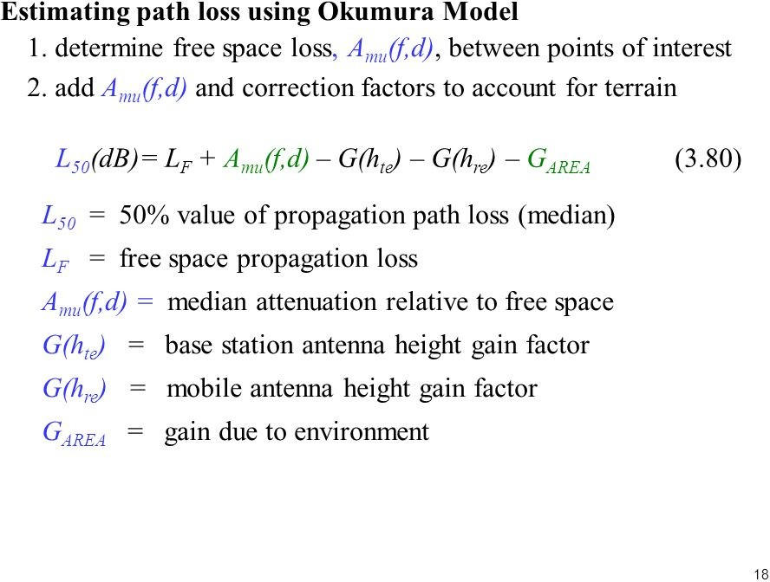

Slide 39
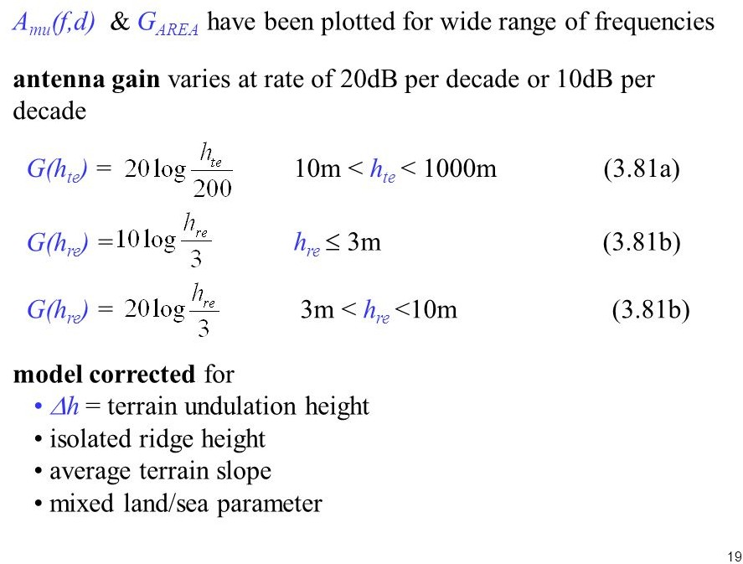

Slide 40
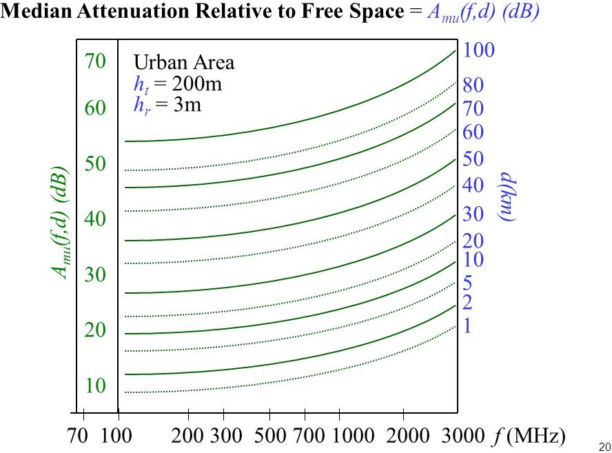


Slide 41
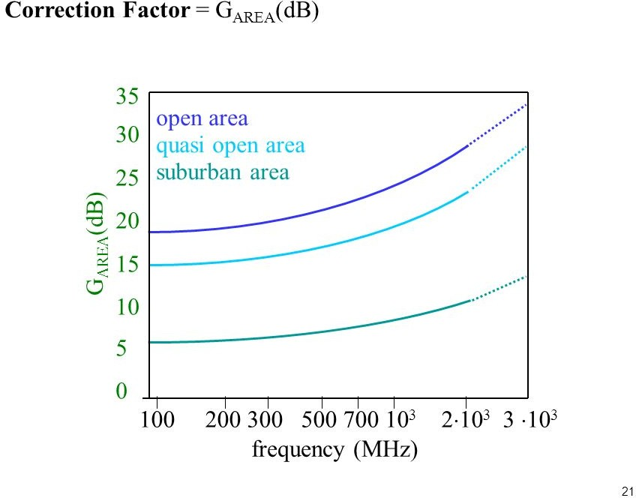

Slide 42
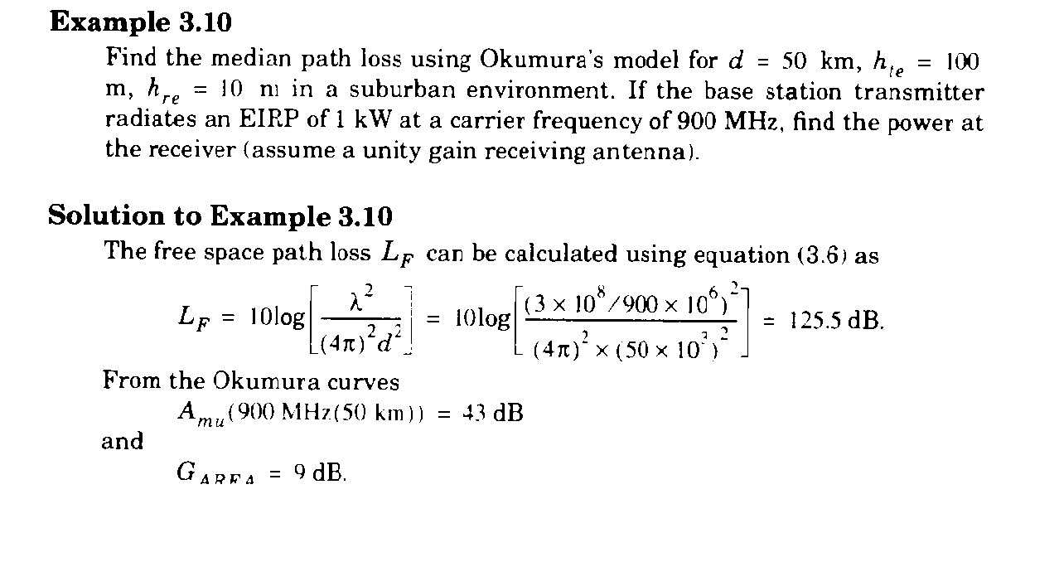



Slide 43
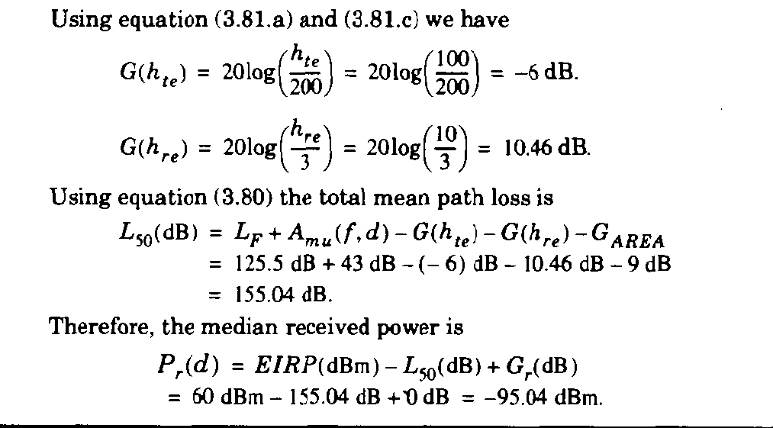

Slide 44
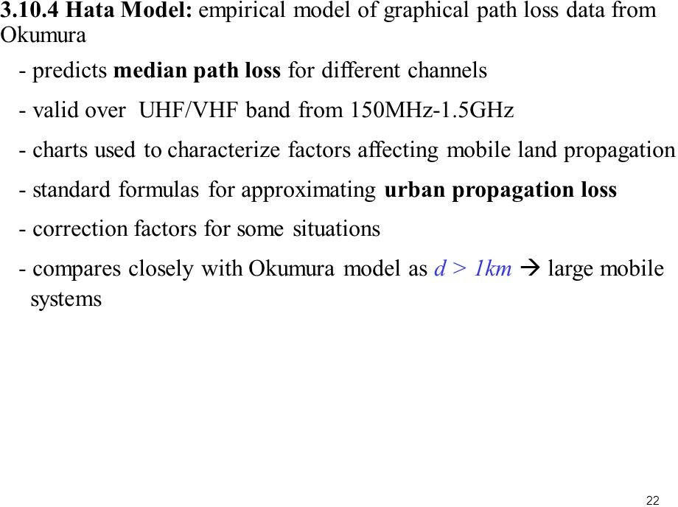

Slide 45


Slide 46


Slide 47


Slide 48


Slide 49


Slide 50


Slide 51


Slide 52


Slide 53


Slide 54


Slide 55

Indoor Multipath Propagation

Slide 56


Slide 57


Slide 58


Slide 59


Slide 60


Slide 61


Slide 62


Slide 63


Slide 64


Slide 65


Slide 66


Slide 67


Slide 68

Large Scale Model

